Slide 1

Candles…
1st group
Abrar Al-Harthi
Rana Al-Ghamdi
Rogaiah Al-Yaba
Samar Sulimani
Sawsan lA- shumrani
2nd group
Sahar Subghah
Dalia Al-amoudi
Zaina Maqadi
Rua’a Halawani

Slide 2

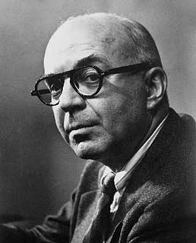
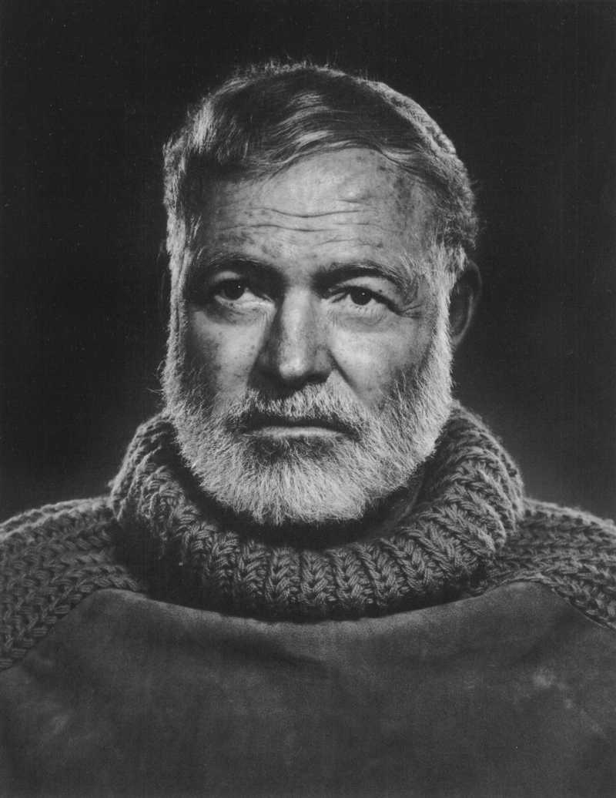
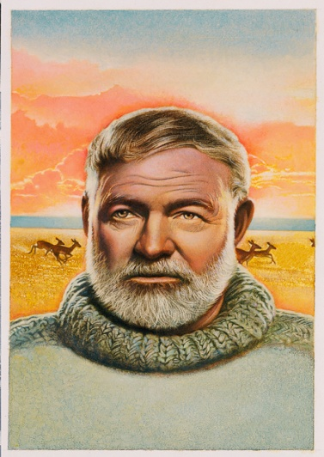
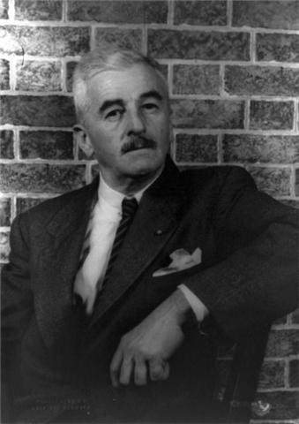
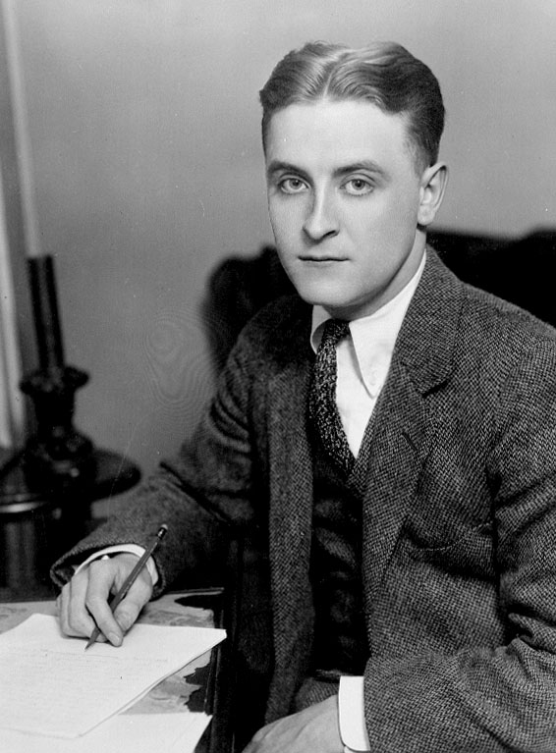
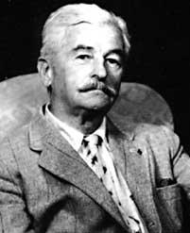
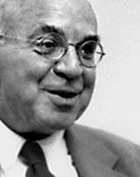
The Writers of the “Lost Generation”

Slide 3
Outline
The Writers of the “Lost Generation”
What is it?
When did it occur?
Who was involved in it?

Slide 4
What is it?
The Lost Generation is a term used to describe a group of American writers who were rebelling against what America had become by the 1900’s.
This term “lost generation" was coined by Gertrude Stein.
These writers felt that America was not such a success story because the country was devoid of a cosmopolitan culture.
Their solution to this issue was to pack up their bags and travel to Europe’s cosmopolitan cultures, such as Paris and London.

Slide 5
Up until this point, American writers were still expected to use the rigid Victorian styles of the 19th Century.
The lost generation writers were above, or apart from, American society, not only in geographic terms, but also in their style of writing and subjects they chose to write about.
Although they were unhappy with American culture, the writers were instrumental in changing their country's style of writing, from Victorian to modern.

Slide 6
They expected to find literary freedom and a cosmopolitan way of life.
A cosmopolitan culture is one which includes and values a variety of backgrounds and cultures.
At this point in time, America had become a great place to, "go into some area of business” (Crunden, 185).

Slide 7
When did it occur?
It occurred between the first and second World Wars, that these writers spent their time abroad.
"In the 1930's, the forces of politics and war drove artists back to America."

Slide 8
Who was involved in it?
Scott Fitzgerald (1896-1940)
Ernest Hemingway(1898-1961)
John Dos Passos (1896 – 1970)
William Faulkner(1897-1962)

Slide 9
Scott Fitzgerald (1896-1940)
In 1917, He became a fashionable army lieutenant, but he was never sent to fight in Europe. Instead, he wrote This Side of Paradise.
Fitzgerald had a feeling that the twenties would end badly both for himself and for America.
Fitzgerald’s life was like the plot of one of his novels.

Slide 10
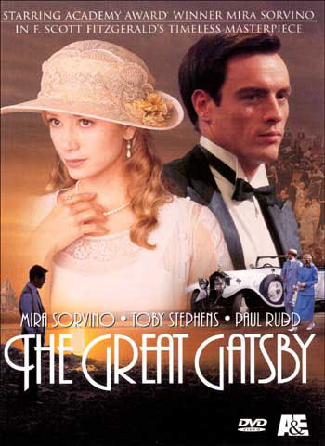
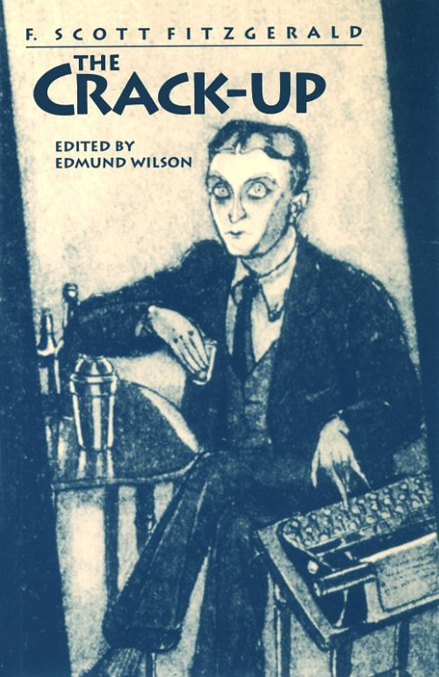
The Great Gatsby
(1925)
The Crack-up

Slide 11
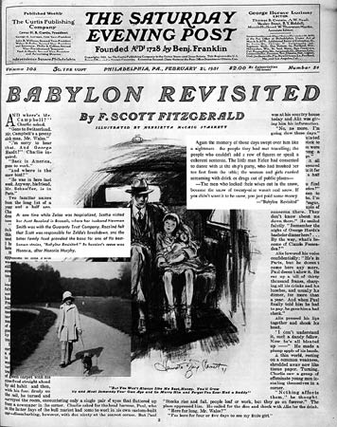

Slide 12
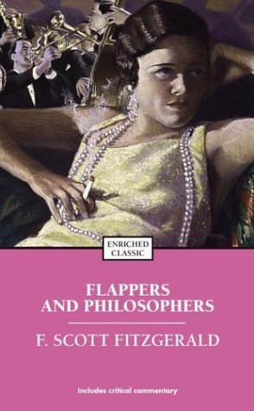
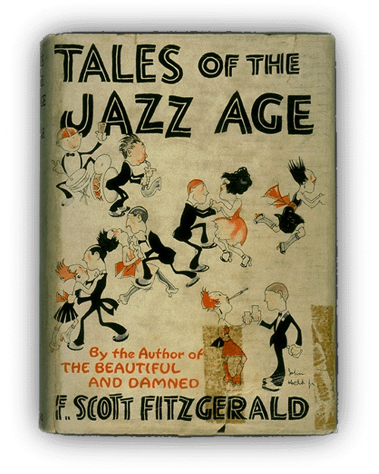
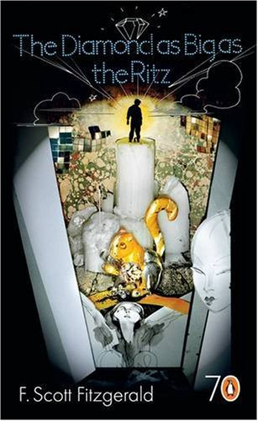
Fitzgerald’S Short Stories
Flappers and philosopher Tales of the Jazz Age The Diamond as Big
as the Ritz

Slide 13
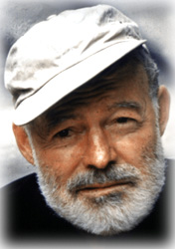
Ernest Hemingway (1898-1961)
He drove an ambulance in World War I and then decided to stay in Paris and become a writer.
He used to deal with symbolism.
The aim of his style “get the most out of the least”.
His language rarely emotional.

Slide 14
He perfected his writing method by experimenting with the short story.
He met Gertude Stein in Paris.
He sometimes repeated a key phrase (e.g. “you’re an expatriate”) to emphasize his theme.

Slide 15
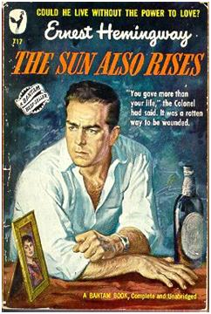
The Sun Also Rises (1926)
His first novel, is a portrait of young adults in the post-war era.
The characters are young American living in Paris. Some had fought bravely for their country. But now they are completely useless in peacetime. Others in the novel are simply “expatriates”, people without a homeland.
Without hope or ambition, they try to enjoy each
day as it comes.

Slide 16
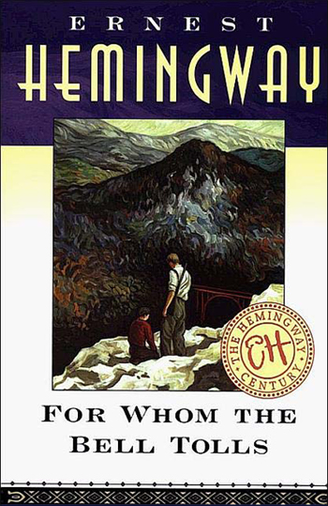
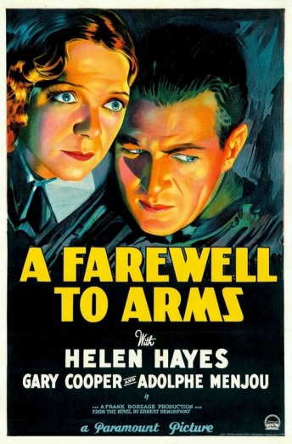
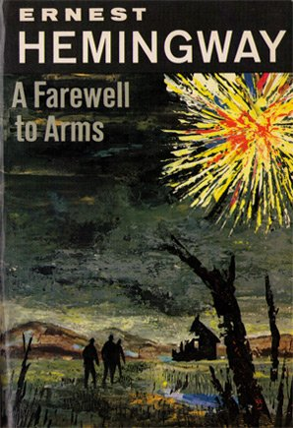
His other works :
A Farewell to Arms (1929)
To Have and Have Not (1937)
For Whom the Bell Tolls (1940)
Across the River and into the Trees (1950)
The Old Man and the Sea (1952)

Slide 17
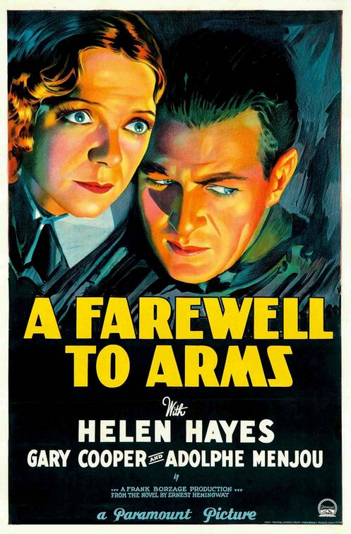
A Farewell to Arms (1929)
Hemingway uses nature symbolically.
It is his famous anti-war love story.
To Have and Have Not (1937)
Hemingway’s heroes began to lose their freshness. Like many other characters in the literature of the thirties, they were “tough-guy” heroes.
Harry Morgan is this kind of hero.
There is a change in Hemingway’s moral theme.

Slide 18
For Whom the Bell Tolls (1940)
The hero, Robert Jordan, is fighting against fascism in the Spanish Civil War. His experience teach him to believe in the value of sacrifice.
At first, he learnt this through love for woman. But at the end as he lies dying, he discovers a similar “union” with nature and the earth.
Jordan has learned about the power of love.

Slide 19
At the end
In 1954, he was awarded the Nobel Prize for Literature. As he entered his own old age, he felt his powers as an artist failing.
In 1961, he shot himself with his favourite hunting gun.

Slide 20
John Dos Passos (1896 – 1970)
He drove the ambulance during world – war I.
Like other members of the lost generation, Dos Passos saw the modern, post- war world as ugly and dirty.
To Dos Passos, only art, and invention of new artistic styles (“ modernism ”), could save the world.

Slide 21
He wrote novels, his One Man’s Initiation ( 1917 ) is considered as the first American novel about that war.
His Three soldiers ( 1921 ) is less personal broader, more historical view.
Back to “modernism” novel, Manhattan Transfer ( 1925 ) was his first successful novel.
In this and other novels, Dos passos has been influenced by the techniques of the movies.

Slide 22
Manhattan Transfer tried to show the purposelessness of history.
He published the first volume of his great “ U.S.A” trilogy, The 42nd Parallel.
All three books in the trilogy use movie techniques to tell the history of the entire nation in the early 20th century.
All three books, his descriptions are extremely sharp and clear.
The great French philosopher Jean Paul Sartre said “ I regard Do Passos as the greatest writer of our time”.
Alfred Kazin, who was a brilliant young critic, called the book “ Dos Passos’s Invention”.

Slide 23
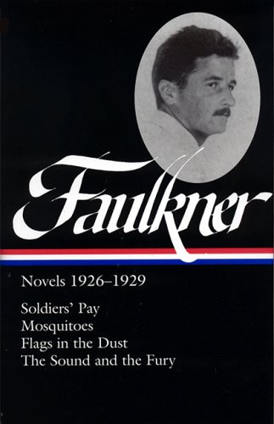
William Faulkner (1897-1962)

Slide 24
The Lost generation
The strong dislike for The belief in the
The post -war world The value of the art

Slide 25
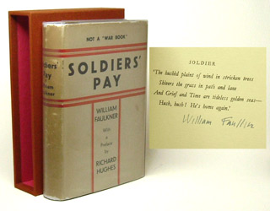
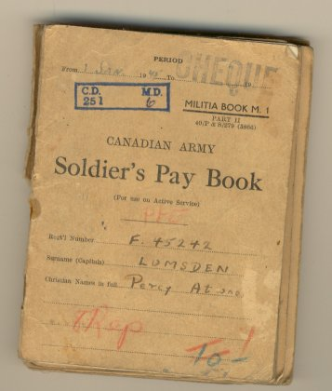
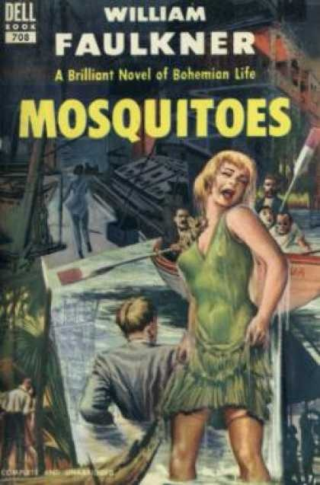
Soldiers’ Pay
(1926)
It is about a wounded soldier who returns home to “ wasteland “ of the post – war society.
Mosquitoes
(1927)
It is a dull tale about artists and art lovers in New Orleans in 20^{s} century.

Slide 26
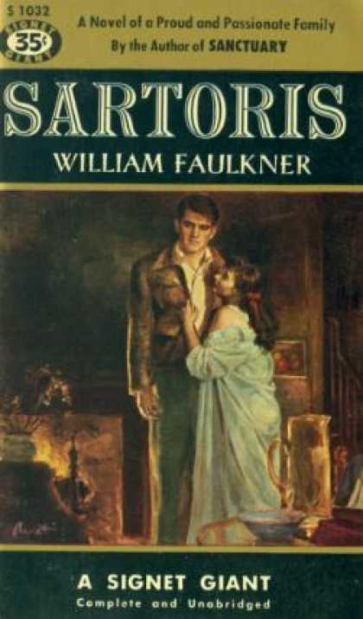
Sartoris (1929)
He decided that his own “ little postage stamp of oil” in Mississippi was worth writing about” .
His mythical Yoknapatawpha county became one of the most famous mini-worlds.
This story contrasted many issues:
* The modern people with the characters from the past.
* The Sartoris family with the Snopes family.

Slide 27
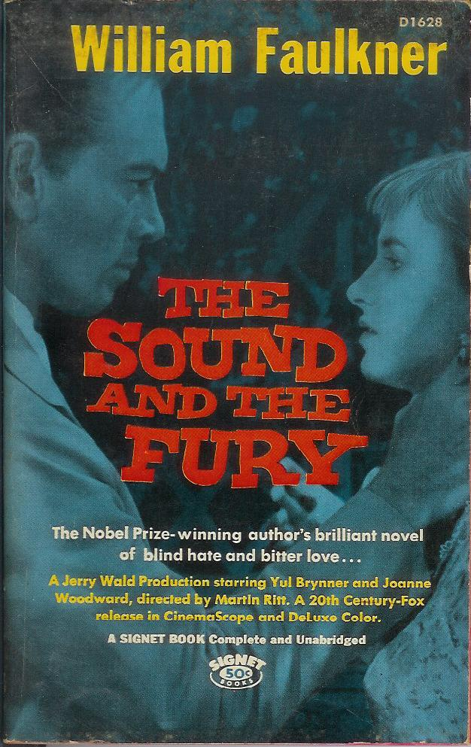
The sound and The fury
(1929)
It is a tragic story of the Compson family.

Slide 28
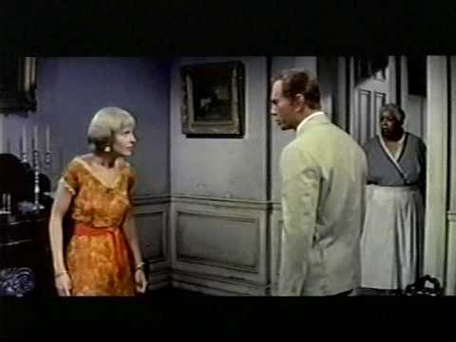
The different points of view in the story:
Benjy Quentin Jason Dilsey

Slide 29
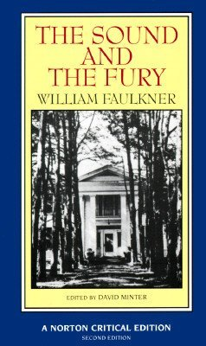
The experimental features in the
Sound and the fury:
1- The use of the limited point of view.
2- The use of special technique of narration.

Slide 30
The Style of William Faulkner
The use of (continuous present).
Faulkner’s powerful descriptions of both human goodness and human evil.
The use of stream of consciousness.

Slide 31


